Slide 1
Modeling tokens on Blockchain (IBM) Final presentation 234313
Naomie Abecassis
David Valensi
Tutors:
Dany Moshkovich
Artem Barger

Slide 2
Team

Slide 3
Goals
Throughout the project we:
Learned Blockchain basics
Got familiar with the Blockchain Ethereum test network
Got familiar with solidity object-oriented language
Got familiar with ganache test environment
Implemented different version of ownership and rental assets using smart contracts in 3 steps
Implemented a dynamic dependency between tokens

Slide 4
Methodology
The goal of this project is to explore ways to implement dynamic inter-dependency between tokens
We apply that to ownership and rental assets
We implemented the following steps:
First step: no dependency
Second step: static dependency
Third step: dynamic dependency

Slide 5

Achievements
First, we implemented ownership token and rental token independent one of the other
Ownership Token
Rental Token
No dependency

Slide 6
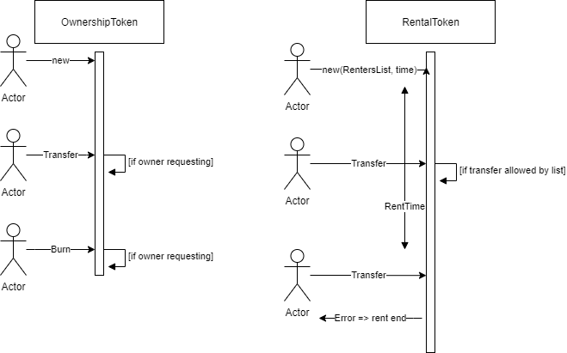
First step sequence diagram

Slide 7
Second step: static dependency
Then, we introduced static dependency between the contracts
Ownership Token
Rental Token
Static dependency
Creates, uses…

Slide 8
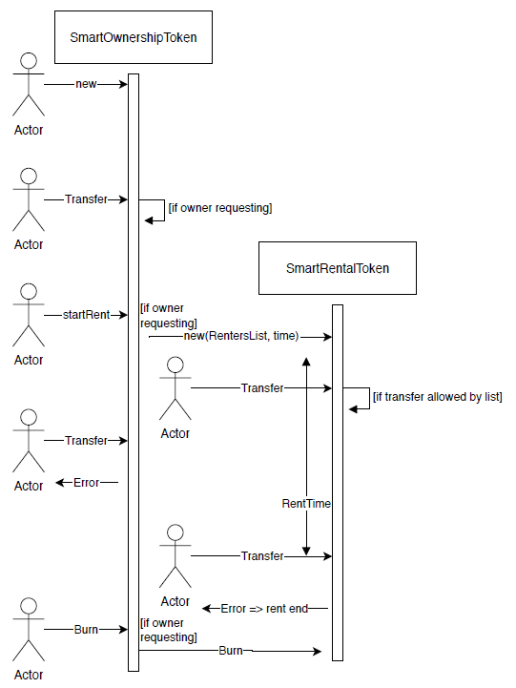
Second step sequence diagram

Slide 9
Third step: dynamic dependency
Finally we updated the dependency to be dynamic, we can now add new extensions to the contracts
Ownership Token
Extension Token
Rental Token
Add
Creates, uses…

Slide 10
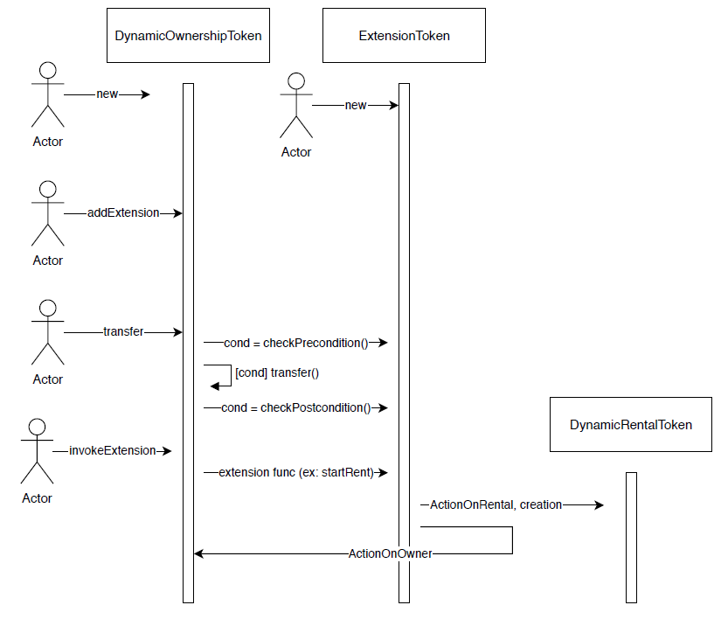
third step sequence diagram

Slide 11
Example
Compile and deploy the code of DynamicOwnership token
Compile and deploy the extension token
Create a DynamicRental token thanks to this extension, and handle actions on it
Write a new code for an extension, for example an option for renting the object
Add this new extension to the existing DynamicOwnership token
Add more conditions to the actions done on the Ownership token

Slide 12
Conclusion
The final implementation supports the requirements that were given at the beginning of the project
However there are some limitations:
The extension token must contain the same state variables as the extended contract (including his parents)
When invoking an extension the errors thrown don’t bubble up
A rental token can be instantiate without an ownership connected

Slide 13
Thank you

